Slide 1

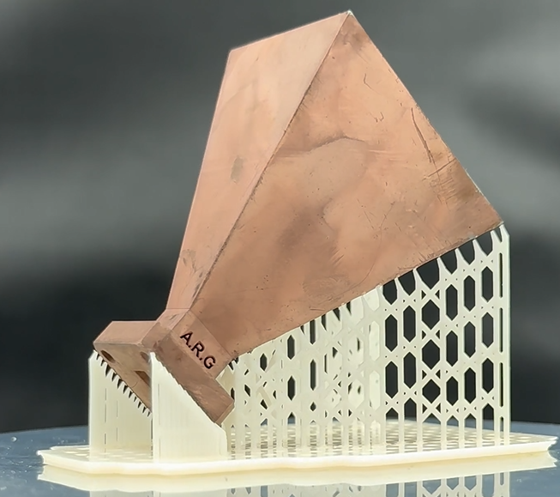
The Design, manufacturing, and implementation of a Ka-band pyramidal horn antenna, using advanced additive manufacturing techniques
Student name: Alec Robin Gould
Student number: 16412117
Supervisor: Professor Mbuyu
Module name: Research Project 1B (HMELE80)
Department: Department of Electrical and Smart Systems Engineering
Date:03/10/2025

Slide 2
Background
Traditional horn antennas: milling, casting, turning
Limitations: complex geometries, cost, time
Additive manufacturing enables intricate, optimized designs
Potential for material savings and cost reduction

Slide 3
Problem statement
Conventional manufacturing struggles at Ka-band (26.5–40 GHz)
High precision needed as frequency increases
Need for cost-effective, flexible, high-performance alternatives

Slide 4
Aim and Objectives
Design, manufacture, and optimize Ka-band pyramidal horn antenna
Use SLA 3D printing + palladium-free electroless plating
Validate through HFSS simulations and measurements

Slide 5
Literature Review
AM in antennas: enables new geometries
Ka-band use cases: satellite, radar, remote sensing
Previous plating: Pd-based, costly – need Pd-free approach

Slide 6
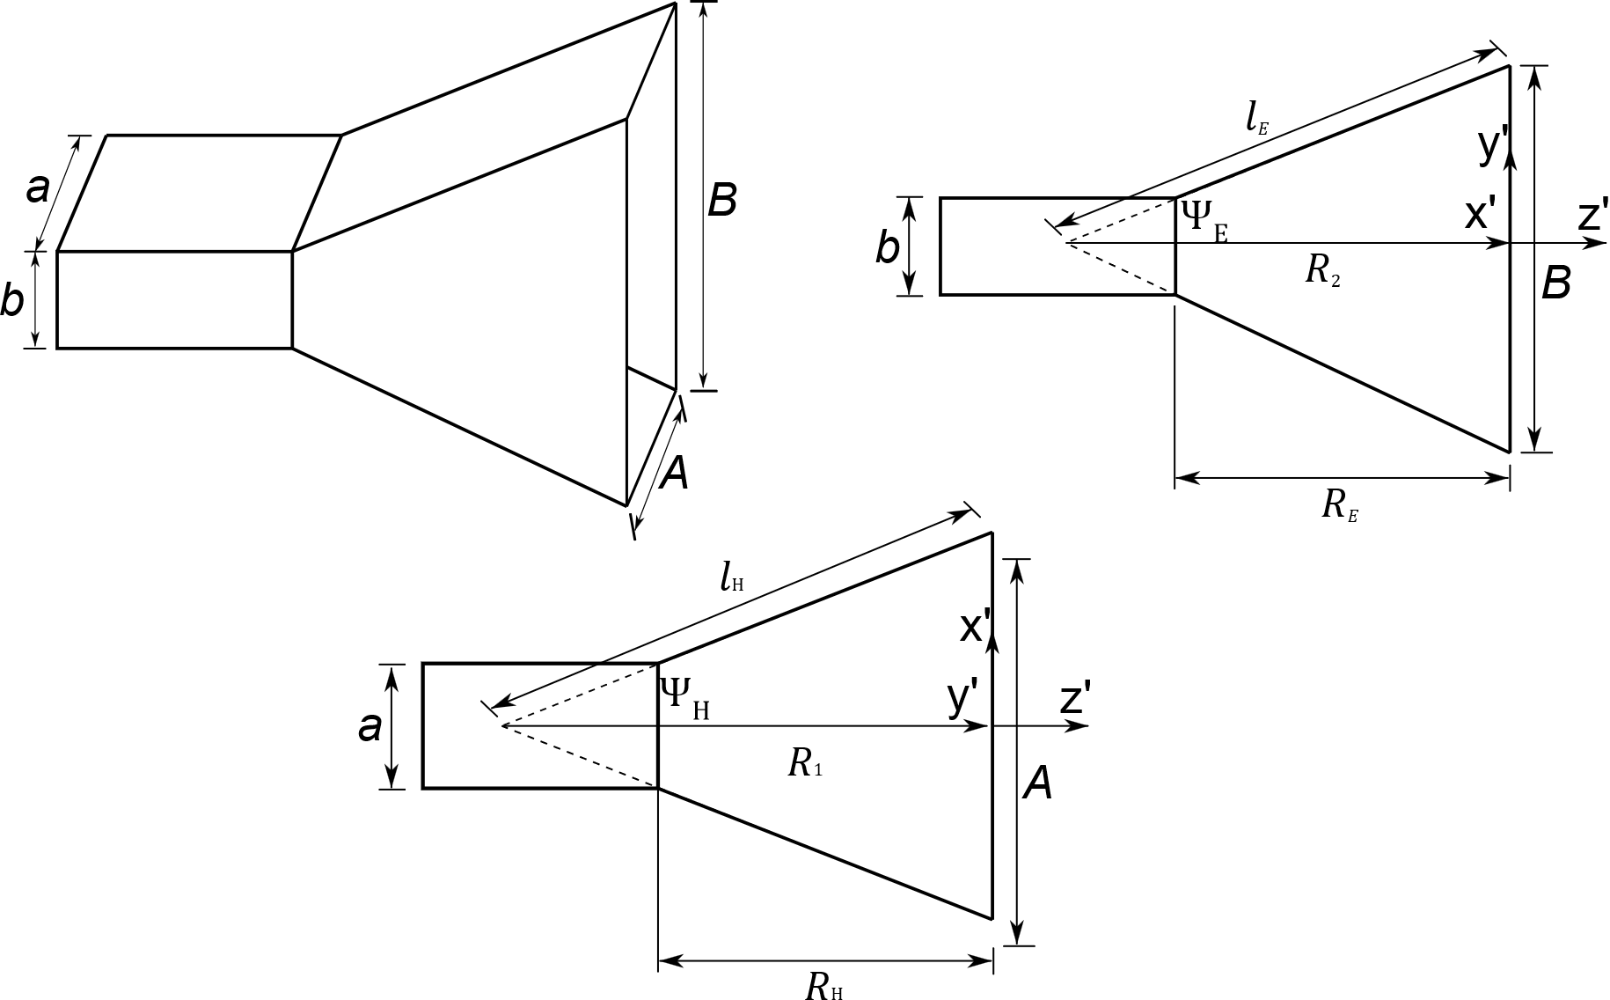
Theoretical Background
Horn antennas: waveguide-to-free-space impedance transition
Pyramidal horns: stable patterns, broadband gain
Field equations define E/H fields, aperture integration

Slide 7
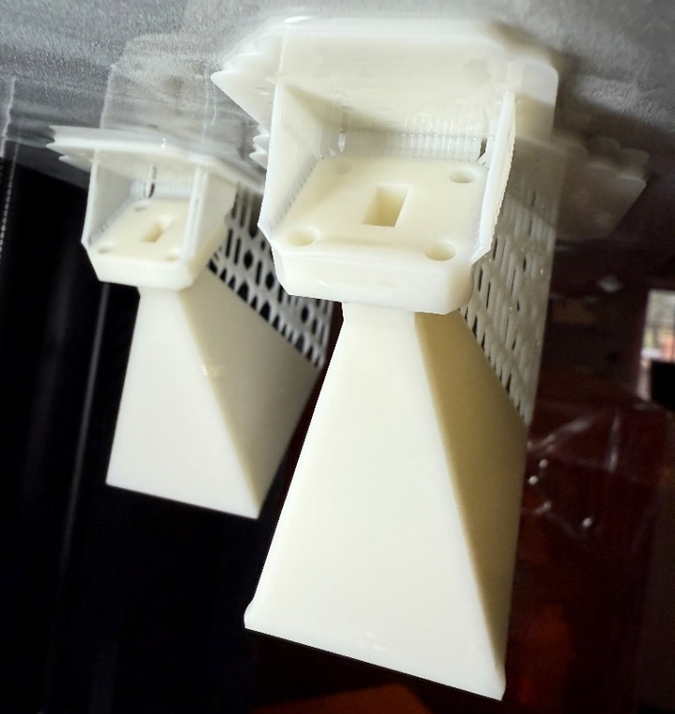
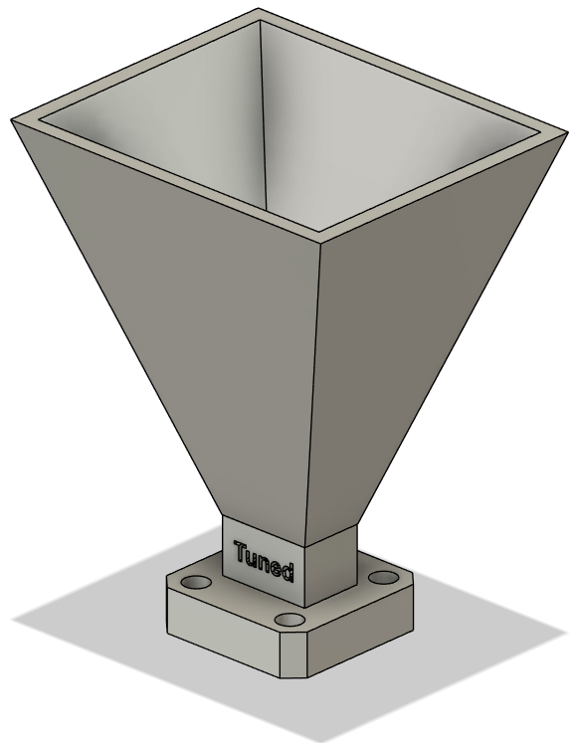
Modeling and Validation
Three design approaches: Traditional, Optimum, Tuned
Formulas define flare dimensions
Validated via HFSS simulations

Slide 8
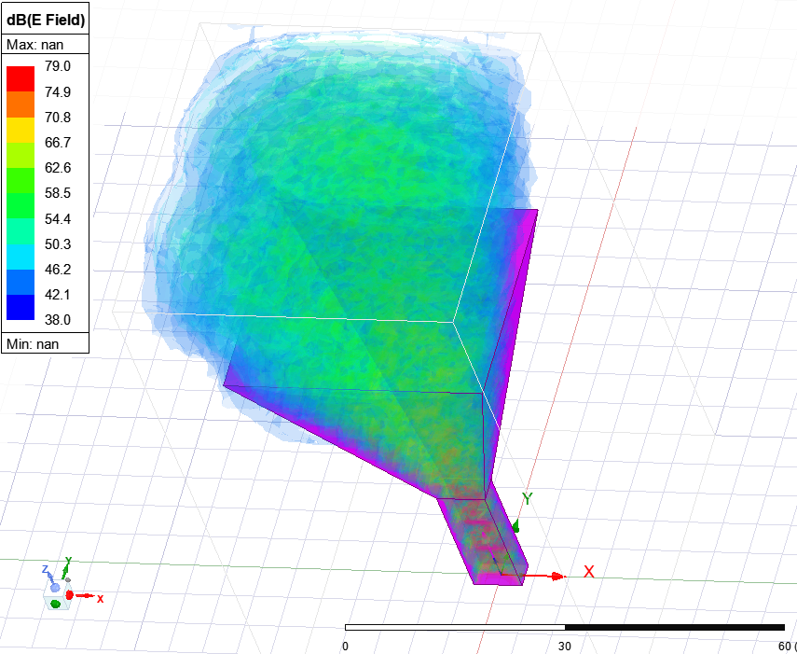
Simulation
Simulated horns with Ansys HFSS
Performance nearly identical across variants
Key metrics: reflection coefficient (S11), gain (S21)

Slide 9
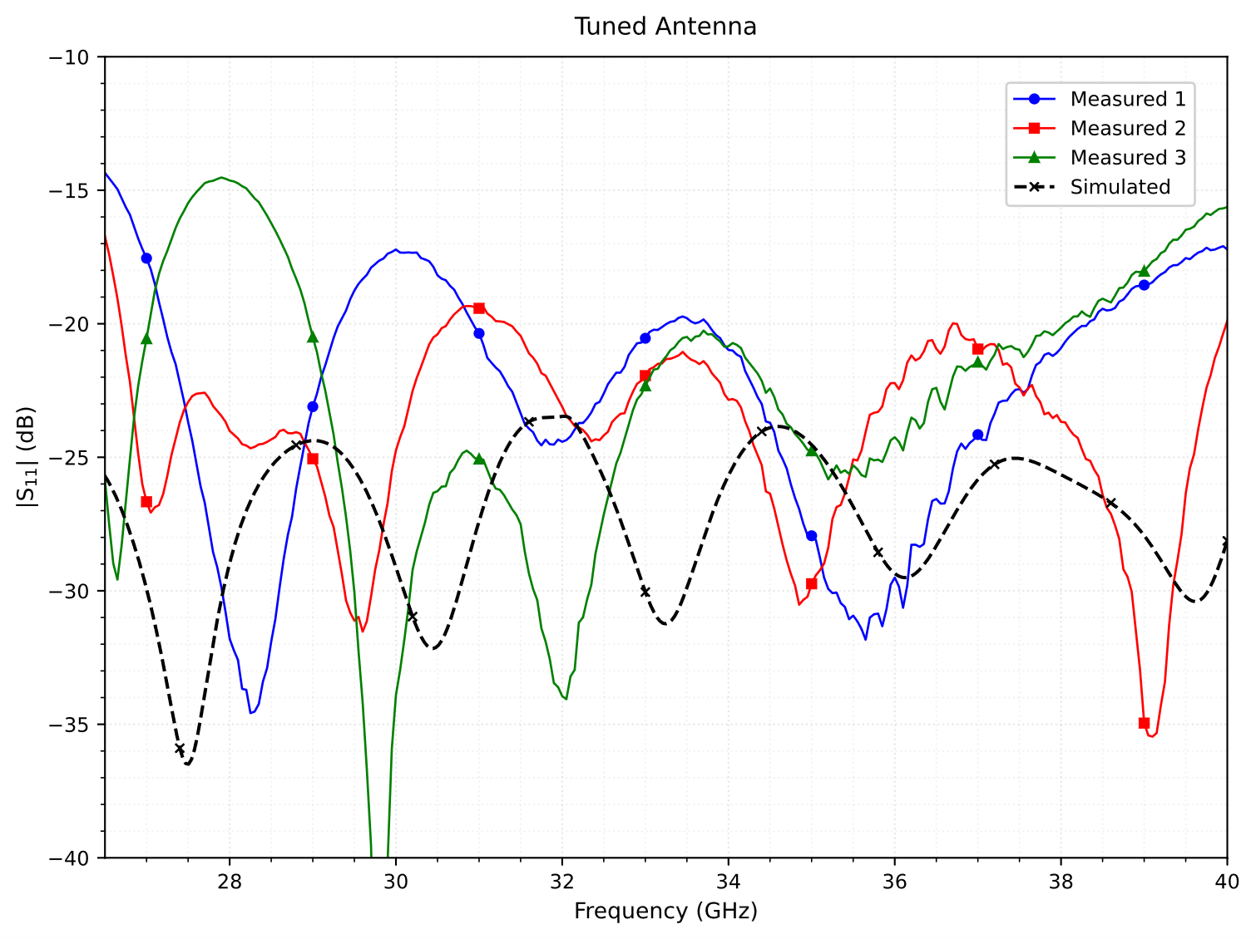
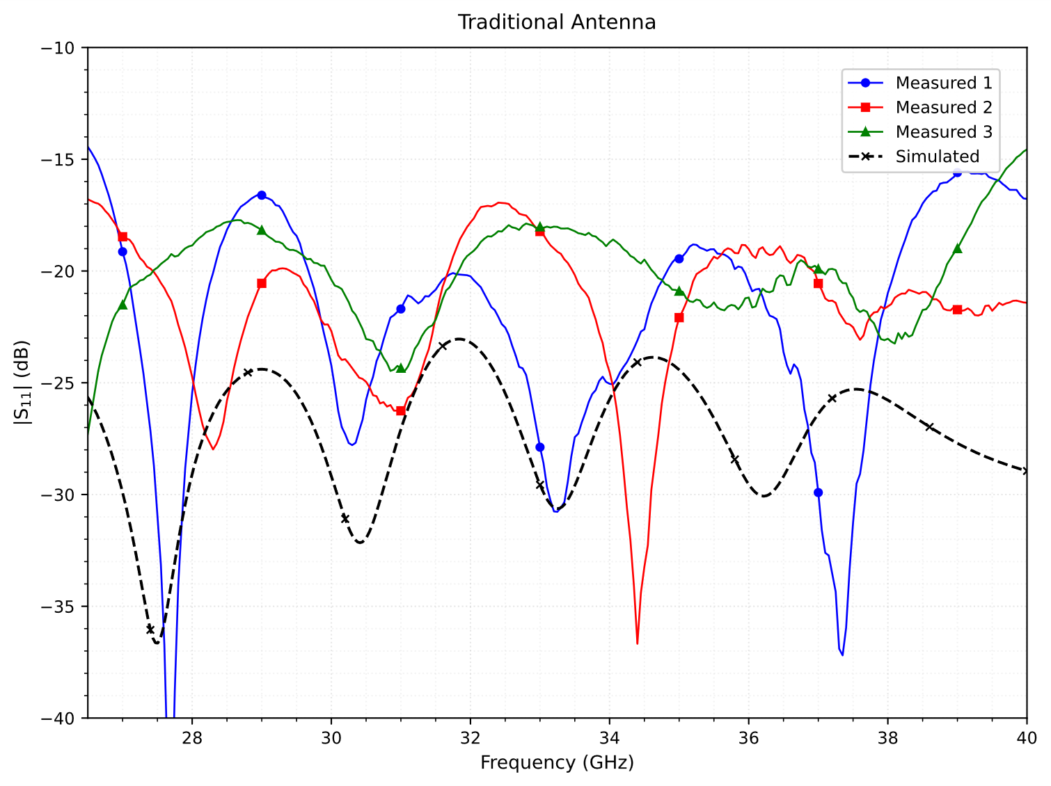
Presentation & Analysis of results
Six antennas 3D printed + copper plated
Reflection coefficients measured (Agilent 8510C VNA)
Performance comparable to simulations (within 2–8 dB)

Slide 10
Analysis
3D printed horns feasible for Ka-band
Measured vs simulated: small deviations due to flange/coupling
Tuned variant performed best (-24 dB S11)

Slide 11
Discussion
3D printing: offers flexibility but tolerances critical
Plating: Pd-free process worked, adhesion verified
Future: include radiation pattern measurement

Slide 12
Challenges Encountered
Balancing support material vs. minimal post-processing
Surface prep and plating chemistry required fine control
Variation between samples: process consistency needs work

Slide 13
Budget
3D printing resin and consumables: low cost
Chemicals for plating: inexpensive, Pd-free
Equipment (HFSS, VNA, adapters) already available

Slide 14
Conclusion
SLA 3D printing + Pd-free plating successful at Ka-band
Performance close to traditional horns
Promising for cost-effective mm-wave antenna research

Slide 15


